Slide 1
Empowering Rural Students with Basic Computer Knowledge: A Community Engagement Initiative at Waje High School

Slide 2
Introduction
As part of our Community Engagement and Service Program, a group of nine students from CKT College conducted a three-day teaching initiative at Waje High School and Junior College, Waje. The aim was to enhance digital literacy among rural students by introducing them to the basics of computer operations, including essential hardware and software concepts. The initiative was designed for students from 5th to 9th standard, ensuring each group received tailored instruction based on their level of understanding.
The sessions were interactive and engaging, combining theoretical learning with hands-on activities. After each teaching session, we conducted oral question-and-answer rounds to encourage active participation and ensure comprehension. The students showed enthusiasm, actively answering questions and demonstrating a keen interest in learning about computers. Their engagement made the sessions enjoyable and meaningful for both the students and our volunteer group.

Slide 3
Day-Wise Activities & Learning Experiences
12/02/2025 Day 1: Teaching basic knowledge of computer to rural student.
On the first day, we conduct the session among student from 5th to 6 th class. in which we conduct 2:30 hours session from 12:00 pm to2:30pm with 5th class student and another 2:30 hours conduct in 2:40 pm to 5:00 pm with 6th class student.
In that session we cover below Topics:
What is a computer? Understanding basic components of computer.
Use of computer in real world.
Which are Input and Output devices computer etc .
Generation of computers Hands-on Activity: We give students components of computer to interact with or know the function about the components of computer.
Oral Question Quiz:
What are the types of computers?
Who is known as Father of the Computer?
What is the main function of CPU?
Which key combination is used to copy and paste?
Which device used for moving crosier? The students actively participated, and the quiz helped them recall key concepts. And they also answered right answer.

Slide 4
13/02/2025 Day 2: Teaching basic knowledge of computer to rural student.
The second day focused on conducting session for 7th and 8 th class student. This session is also conduct from 12:00 pm to 2:30 pm for 7th class and 2:40 pm to 5:00 pm for 8th class.
In that session we cover below Topics:
Introduction to computer.
Types of computer.
Operating system in device’s.
Computer maintenance.
Understanding activity:
We conduct a exam from the ppt we teach to students and give marks to the student. The mode of the exam was a written format, requiring students to demonstrate their knowledge and critical thinking through multiple-choice questions.
Exam contain Questions:
What does an operating system manage?
Name one operating system?
What is first step in a computer basic functions?
What is an operating system work for? The session sparked curiosity among students, and the most of the student answer question correctly.

Slide 5
14/02/2025 Day 3: Teaching basic knowledge of computer to rural student. On the final day, we educated students of 9th class so basically we conduct this session in four class of 9th std for 1:25 hours for each classroom. In that session we cover below Topics • Parts Of computer. • Generation about computers. • Basic knowledge about computer hardware and software. • Basic function of computer. • Carrier guidance about computer science filed. Understanding activity: We conduct a exam from the ppt we teach to students and give marks to the student The mode of the exam was a written format, requiring students to demonstrate their knowledge and critical thinking through multiple-choice questions. Exam contain Questions: 1. What is use of computer? 2. Name one common software name use in day to day life? 3. How to maintain computer? 4. What is purposes of antivirus software? 5. Which are input and output of devices of computer? The final day helped students to get full knowledge of computer working, making them more efficient digital users. Outcomes & Impact The three-day program had a significant impact on students, helping them: • Understand basic computer operations and their importance. • Know about the how computer components are work. • Know the use meaning of software and hardware and its applications. • How to handle computer with efficiently and how they can reduce their efforts in study , problem solving using computer. For the volunteers, it was a valuable learning experience, enhancing our teaching, communication, and leadership skills while contributing to digital literacy in the community.
14/02/2025 Day 3: Teaching basic knowledge of computer to rural student.
On the final day, we educated students of 9th class so basically we conduct this session in four class of 9th std for 1:25 hours for each classroom.
In that session we cover below Topics
Parts Of computer.
Generation about computers.
Basic knowledge about computer hardware and software.
Basic function of computer.
Carrier guidance about computer science filed.
Understanding activity:
We conduct a exam from the ppt we teach to students and give marks to the student The mode of the exam was a written format, requiring students to demonstrate their knowledge and critical thinking through multiple-choice questions.
Exam contain Questions:
What is use of computer?
Name one common software name use in day to day life?
How to maintain computer?
What is purposes of antivirus software?
Which are input and output of devices of computer?
The final day helped students to get full knowledge of computer working, making them more efficient digital users.

Slide 6
Objectives
Introduce students to basic computer operations and applications.
Explain Basic components of computer.
Educate students on software and hardware of computer.
Make learning engaging through hands-on activities, discussions, and quizzes.
Develop students' curiosity, problem-solving skills, and digital awareness.

Slide 7
Outcomes
The three-day program had a significant impact on students, helping them:
Understand basic computer operations and their importance.
Know about the how computer components are work.
Know the use meaning of software and hardware and its applications.
How to handle computer with efficiently and how they can reduce their efforts in study , problem solving using computer.
For the volunteers, it was a valuable learning experience, enhancing our teaching, communication, and leadership skills while contributing to digital literacy in the community

Slide 8
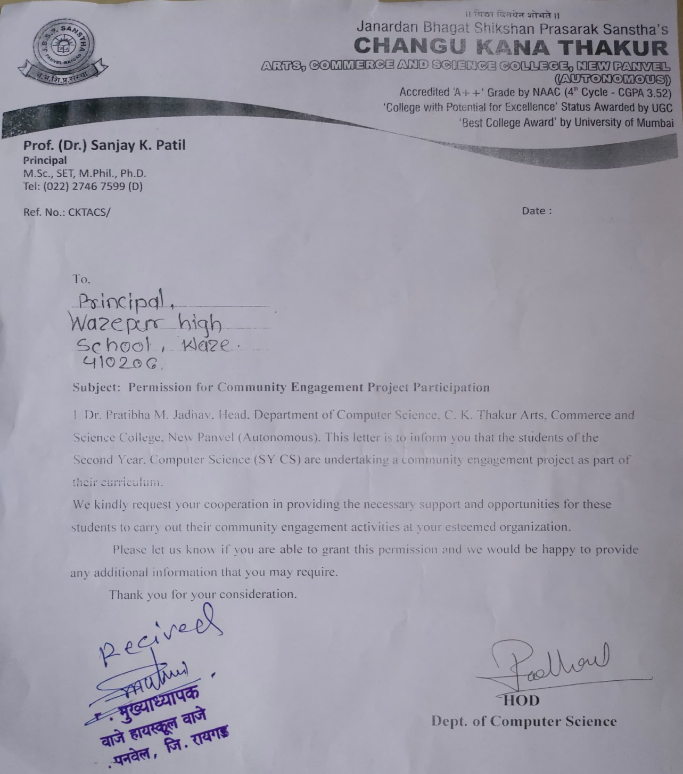
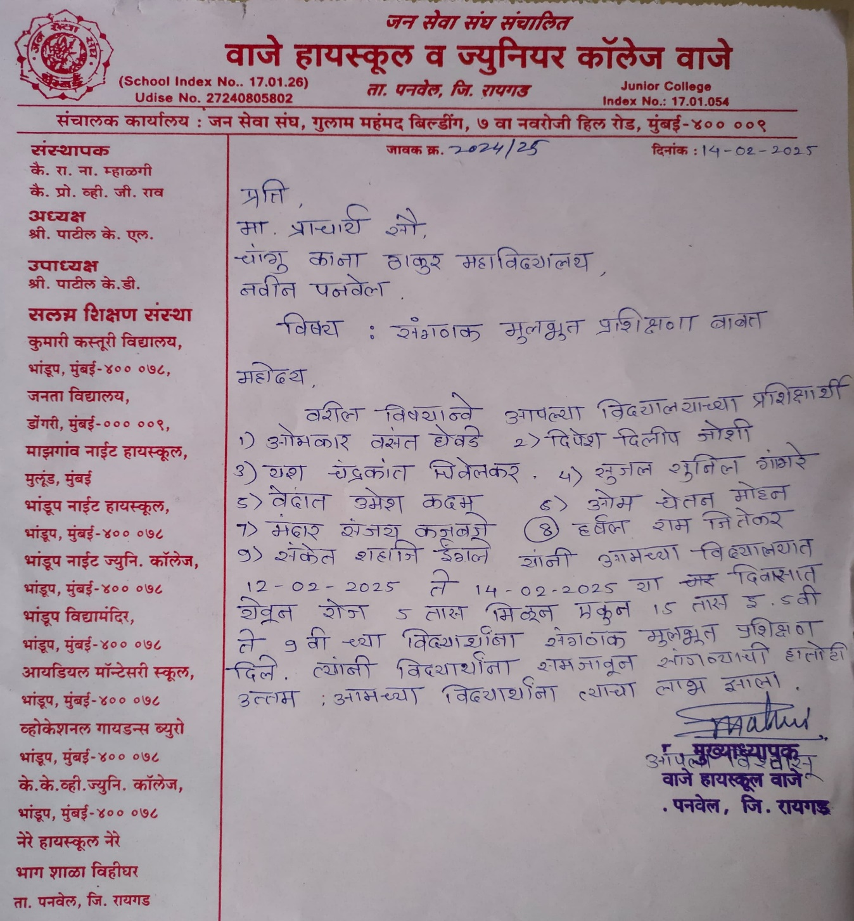
Letters

Slide 9
Thank You

